Slide 1
Rolling Manipulation
Federico Bernabei, Muhammad Sunny Nazeer, Michele Francesco Penna, Ebrahim Shahabishalghouni
Contattaci: #week5 sul Slack

Slide 2
(Michele)

Slide 3
Some terms in differential geometry
Manifold
Injective/Surjective/Bijective
R3, S2, SE(3)
Patch, Atlas
Gauss Map
(Non-) Holonomic Dynamics

Slide 4
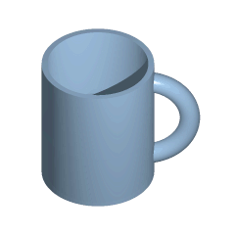
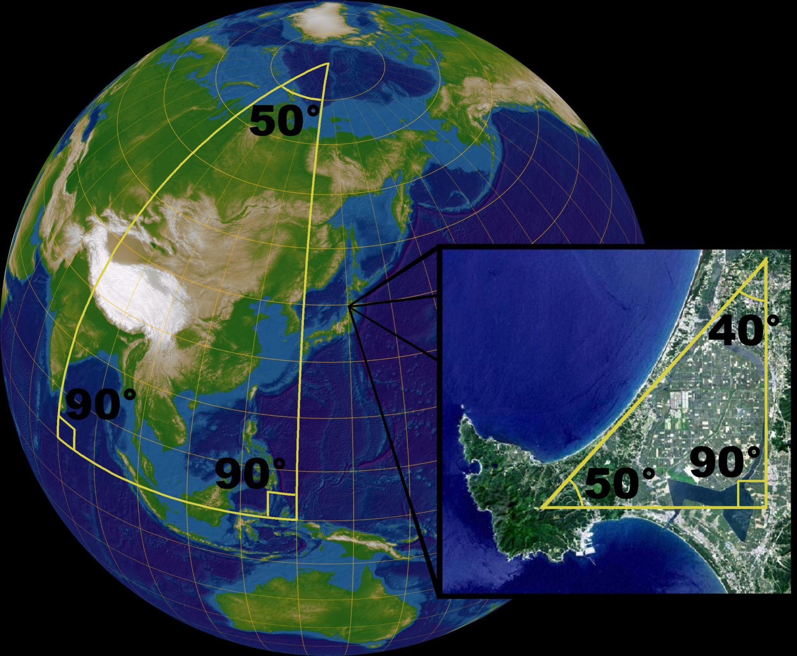
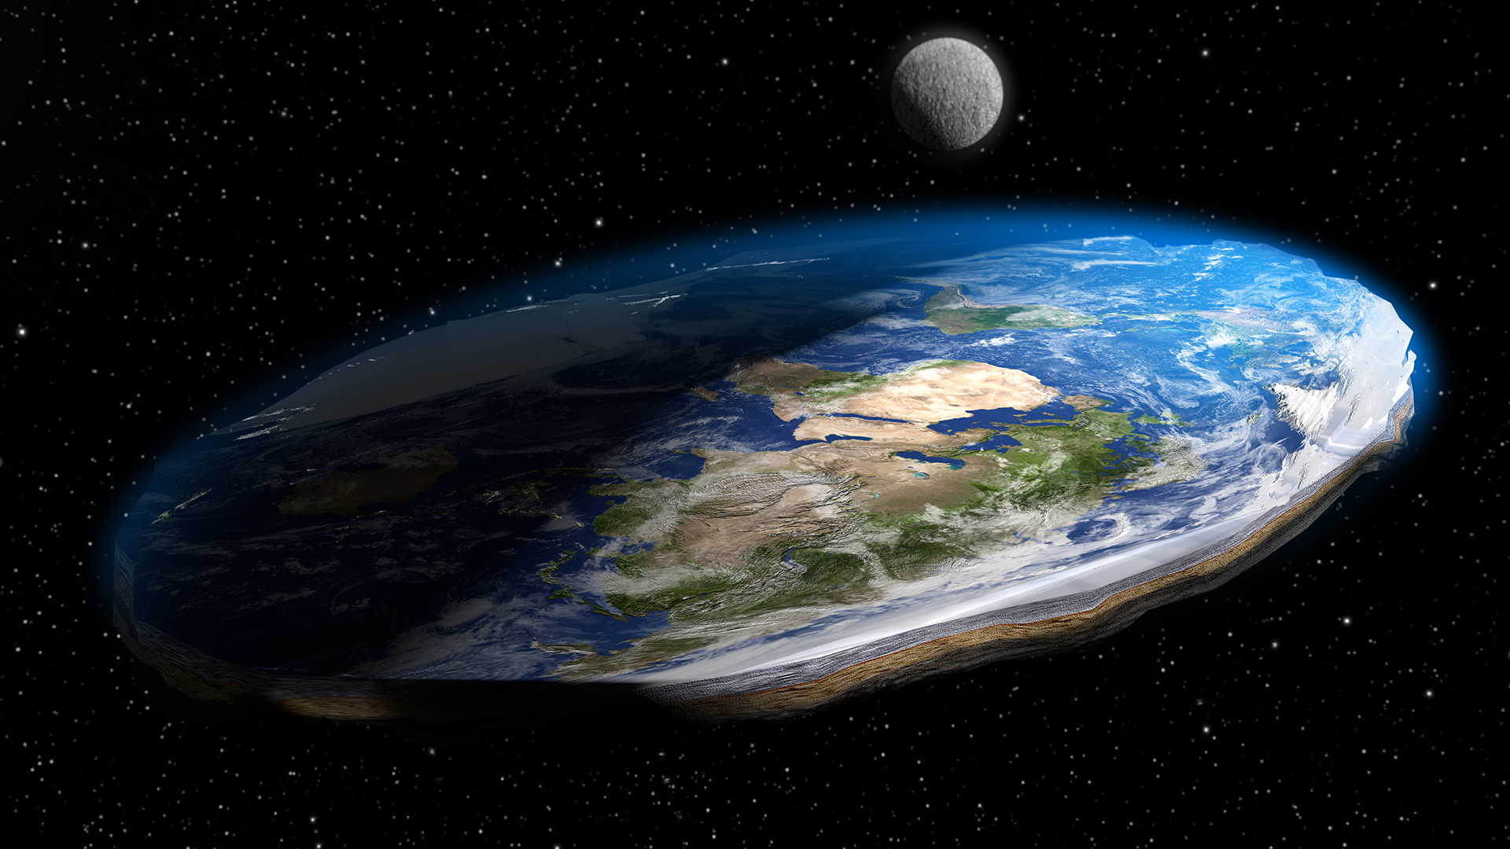
Terminology: Manifolds
A manifold is a topological space that is locally Euclidean (i.e., around every point of an n-dimensional manifold, there is a neighborhood that is topologically the same as the Euclidean space of dimension n)
A coffee mug is topologically the same as a donut.
???
Notes:
Homeomorphism = mapping that preserves the topological properties of the space
In the metaphor, the mug and the donut are one and the same. If they were made out of rubber, one could be twisted and stretched into the shape of the other without changing its essence.
"You can put your finger through the hole in a teacup handle, but you can't put it through a potato, so these are two different categories of topological objects,"
Flat Earth: The discrepancy arises essentially from the fact that on the small scales that we see, the Earth does indeed look flat. In general, any object that is nearly "flat" on small scales is a manifold, and so manifolds constitute a generalization of objects we could live on in which we would encounter the round/flat Earth problem
http://mathworld.wolfram.com/Manifold.html

Slide 5
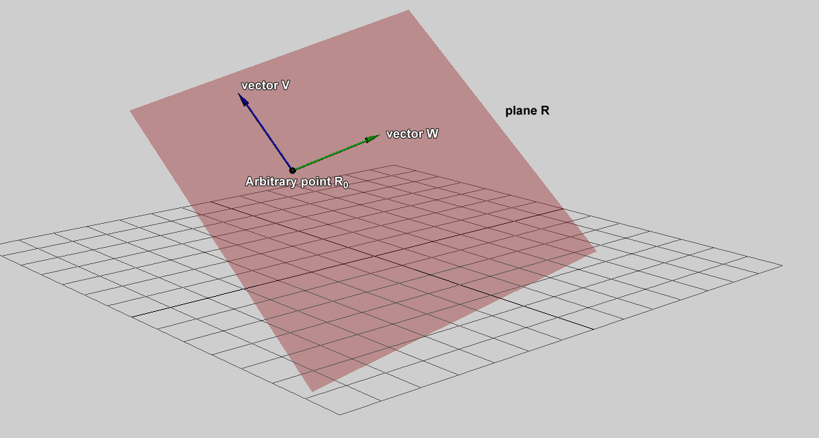
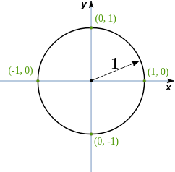
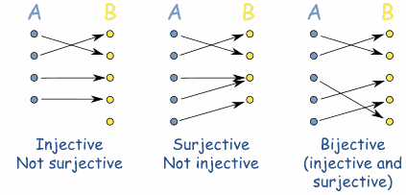
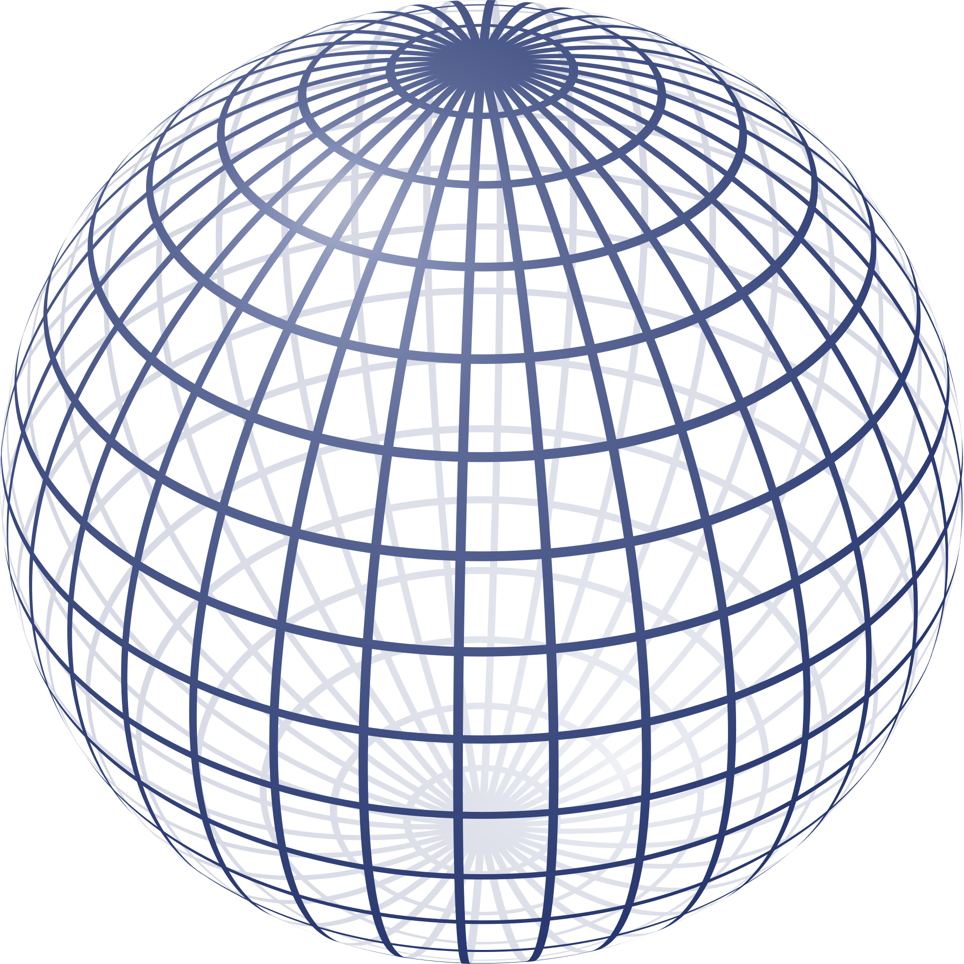
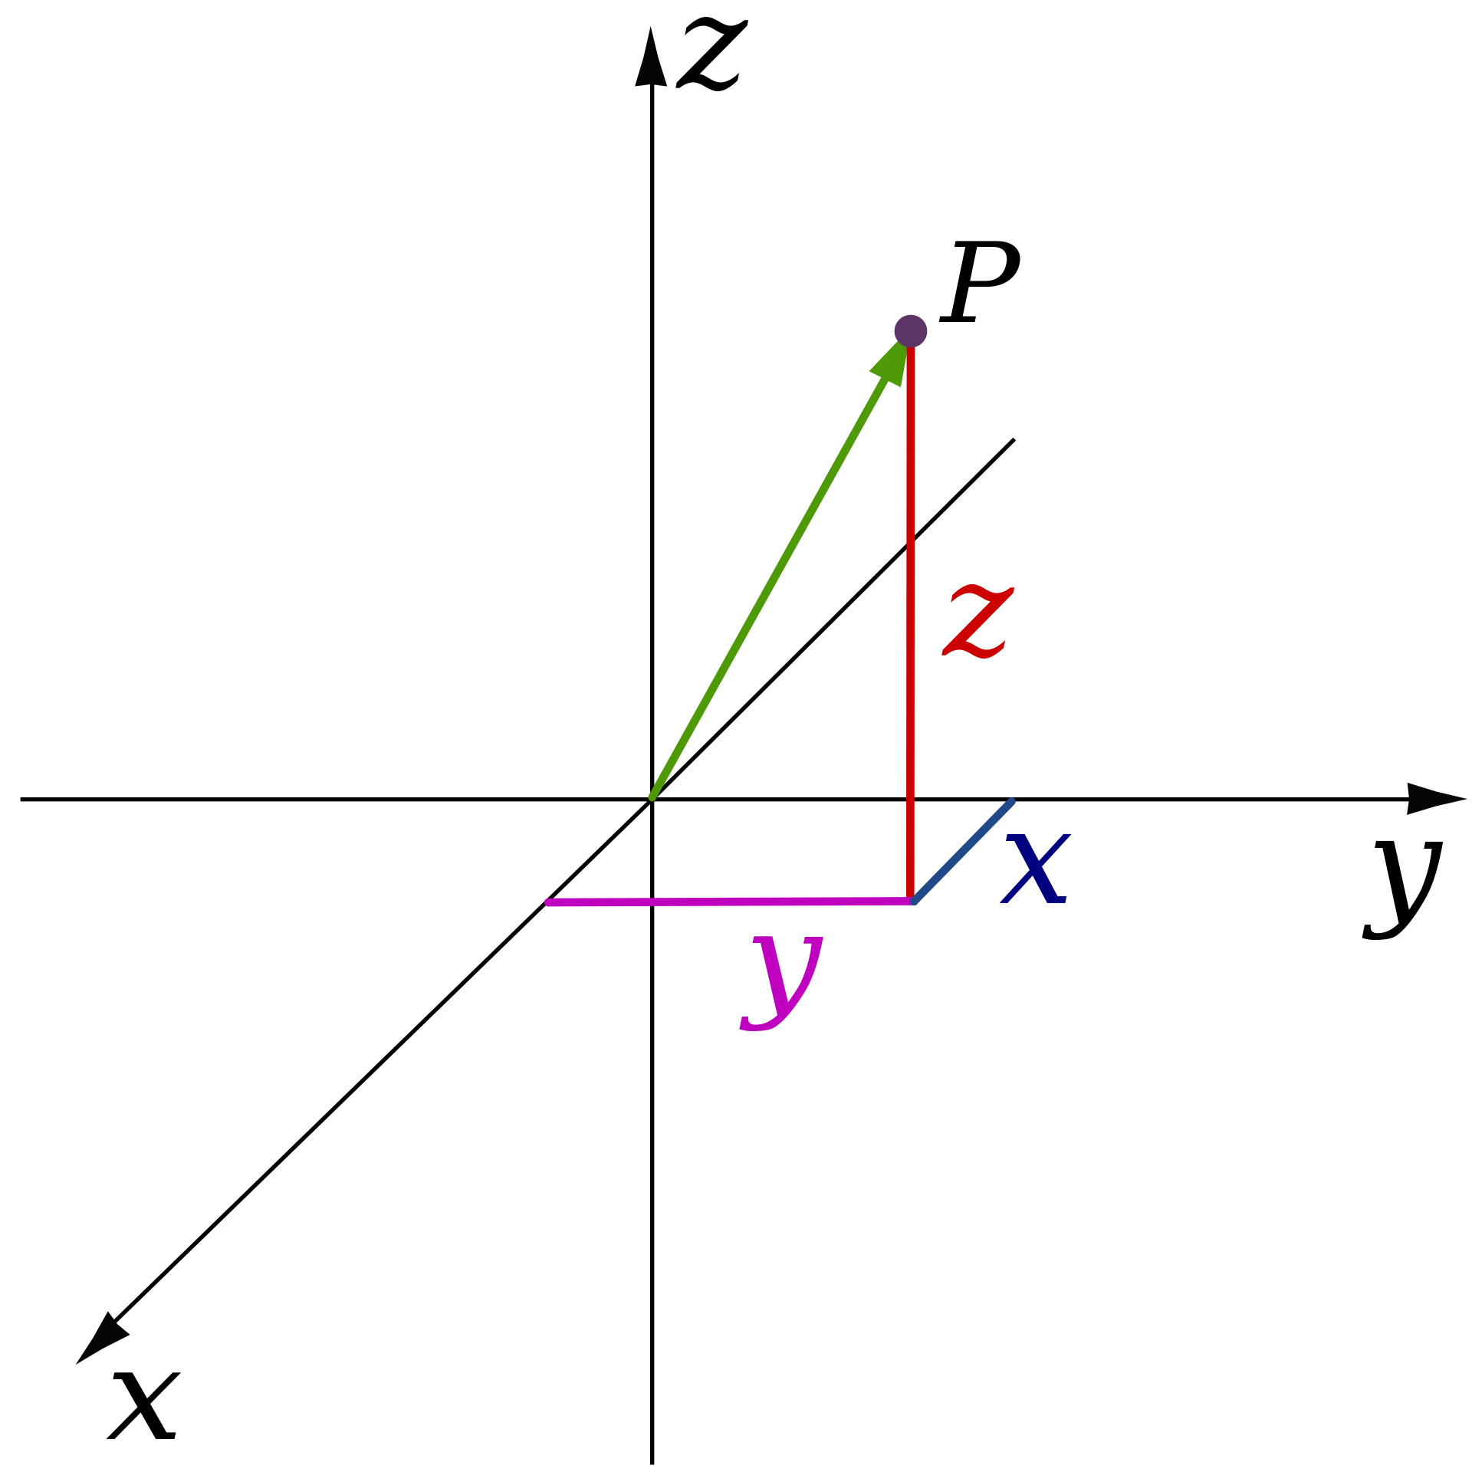
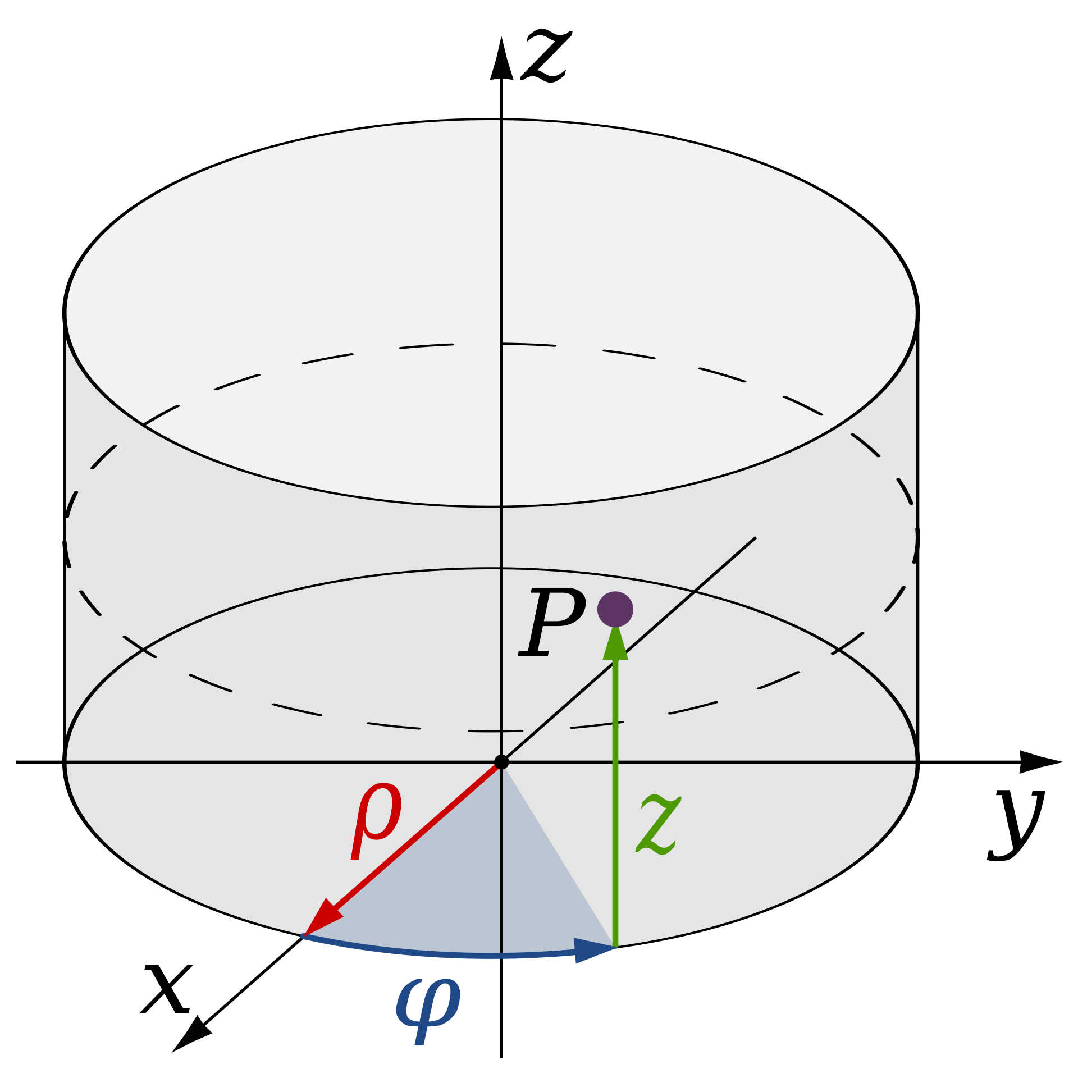
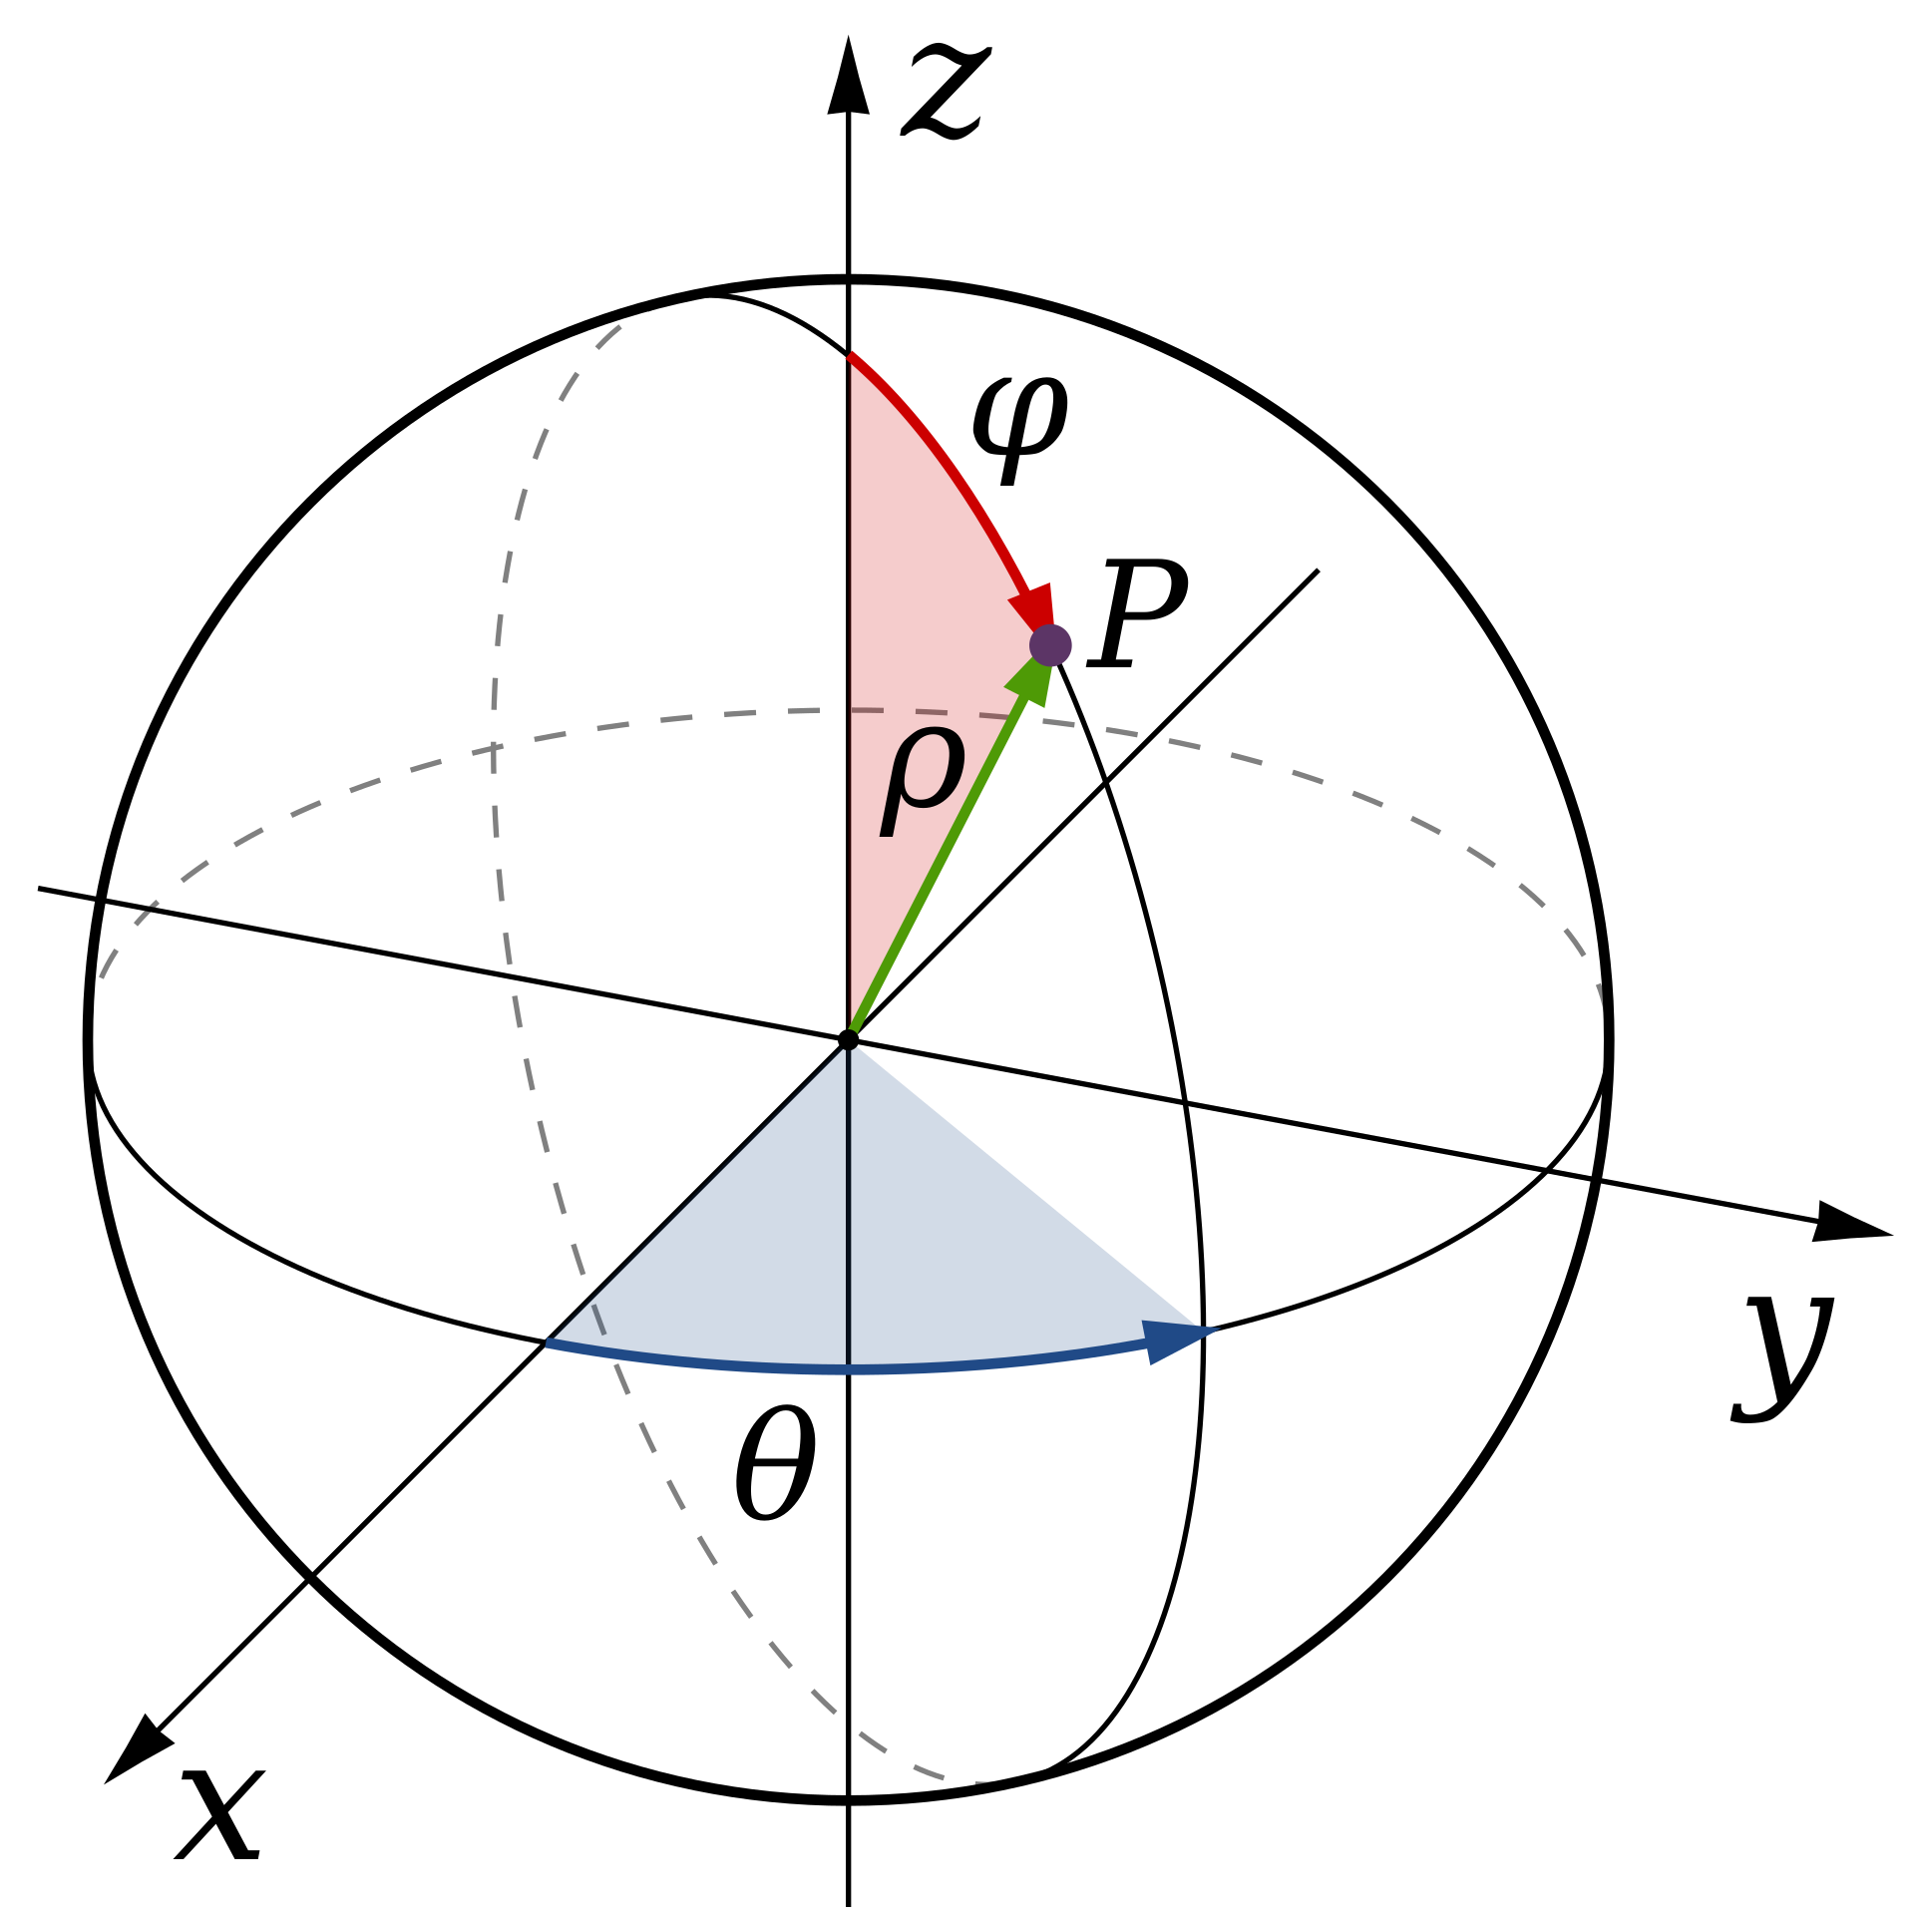
Maps and Spaces
R²
S¹: unit circle
R³
A function is invertible if it is bijective
S²: unit sphere
(2D surface in 3D space)
Notes:
Example: latitude, longitude fully define position on S2

Slide 6
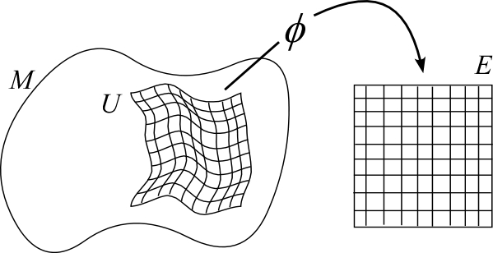
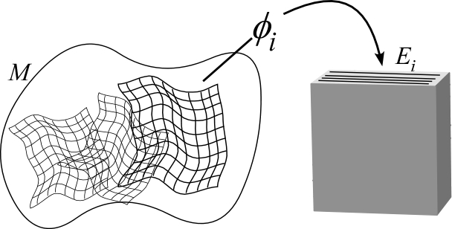

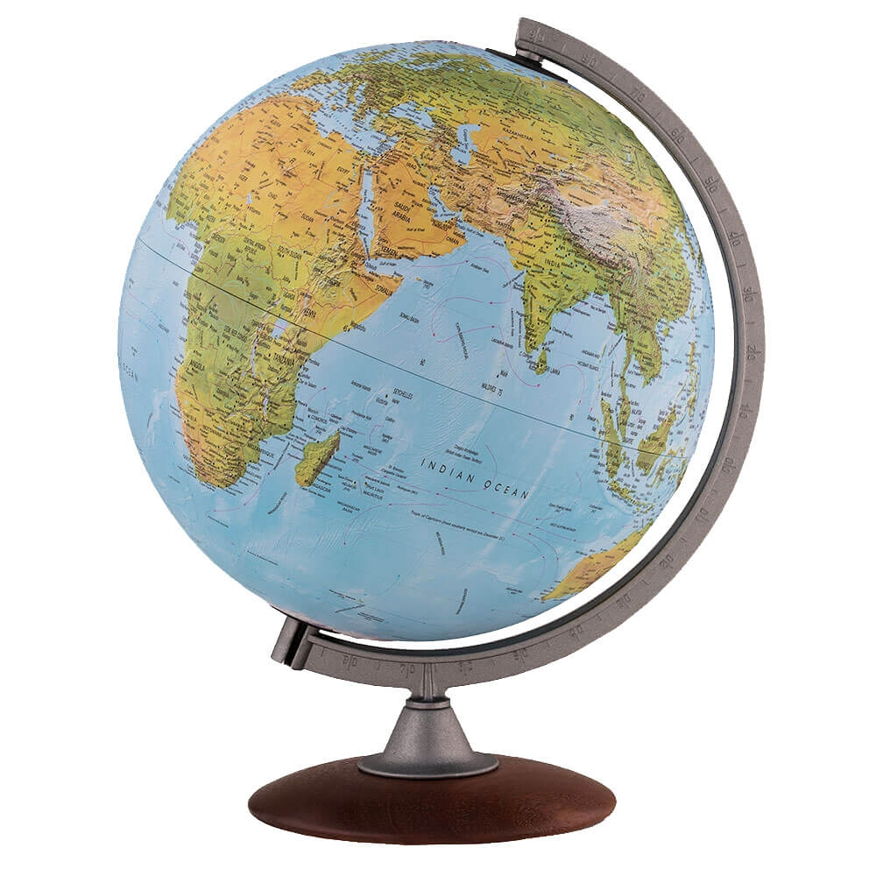
Terminology: Patch, Atlas, and Manifold
f
U
Patch: Surface S in R³ for which there exists an invertible map from U in R²:
f:U➝S
Atlas: Set {S_{i}} of patches
Manifold: Union M = ⋃S_{i} of patches
S
f_{i}
U_{i}
Notes:
http://www.people.vcu.edu/~urgowdy/phys591/html/mod/031/s1.html
https://previews.123rf.com/images/arogant/arogant0906/arogant090600013/5002539-two-opened-old-atlas-book-on-the-spread-map.jpg
https://cdn3.volusion.com/bstu5.rxjt6/v/vspfiles/photos/WP21106-2.jpg

Slide 7
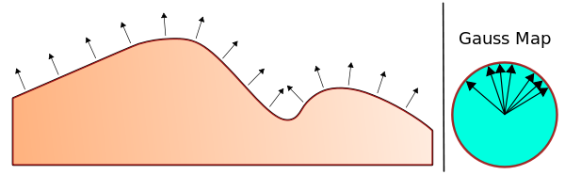
Terminology
Gauss map
In differential geometry, the Gauss map of a surface maps that surface in Euclidean space R3 to the unit sphere S2. Namely, given a manifold M lying in R3, the Gauss map is a continuous map g: M → S2 such that g(p) is the vector perpendicular to M at p.
2D example:
g: R2 -> S1
Notes:
Every point on this 2D surface is mapped to a vector in the unit circle S1
https://en.wikipedia.org/wiki/Gauss_map

Slide 8
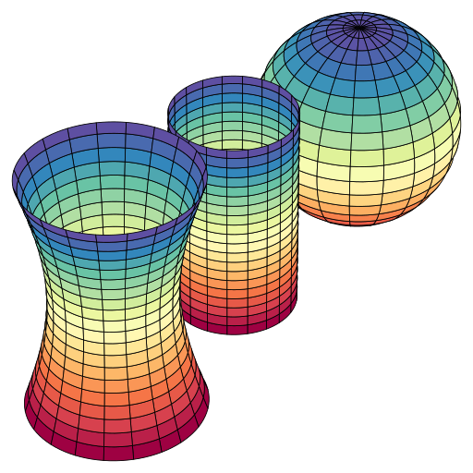
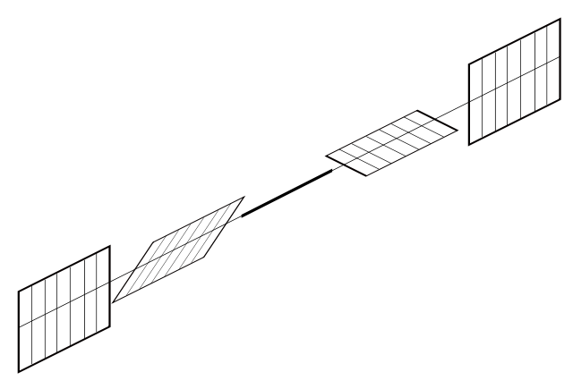
A manifold is characterized locally by curvature [K], torsion [T] and metric [M]
[T] Torsion represents twist along a direction
Gauss curvature [K] can be negative or positive
[M] The Metric tensor allows one to define and compute the length of curves on the manifold.
https://en.wikipedia.org/wiki/Gaussian_curvature

Slide 9
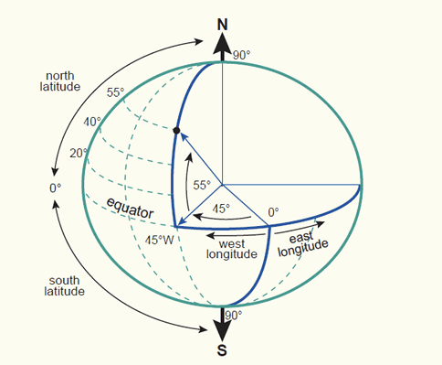
A familiar spherical manifold and coordinate system

Slide 10
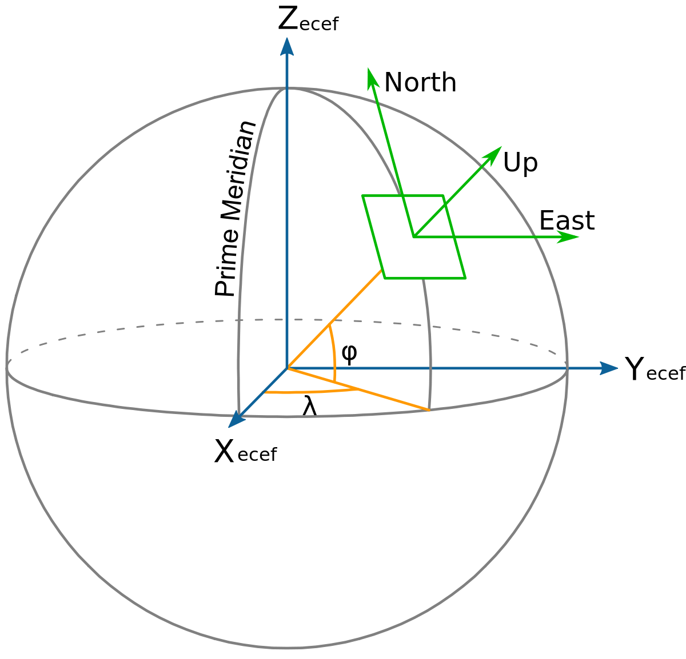
Surface terminology
x(u)
Gauss frame:
Given a coordinate system f:U➝S₀, with coordinate patch S₀ and Gauss map g:S₀➝S2, we define a right-handed, normalized Gauss frame at a point u∊U:
x(u) = f_{u}(u) / || f_{u}(u) ||
y(u) = f_{v}(u) / || f_{v}(u) ||
z(u) = g(f(u))
R
y(u)
(u)
(v)
This is the equivalent of defining a North-West-Up coordinate frame at a point u as a function of latitude (φ) and longitude (λ)
Notation: f_{u}(u) = partial derivative of f with respect to u
See eq. (14) in Montana for the case of a sphere -- with [K], [T] and [M] given in eq. (15).
Notes:
F maps 2D patch to surface in R3
Fu, fv partial derivatives

Slide 11
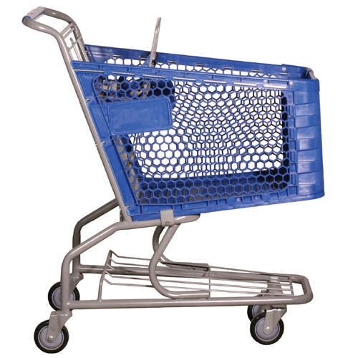
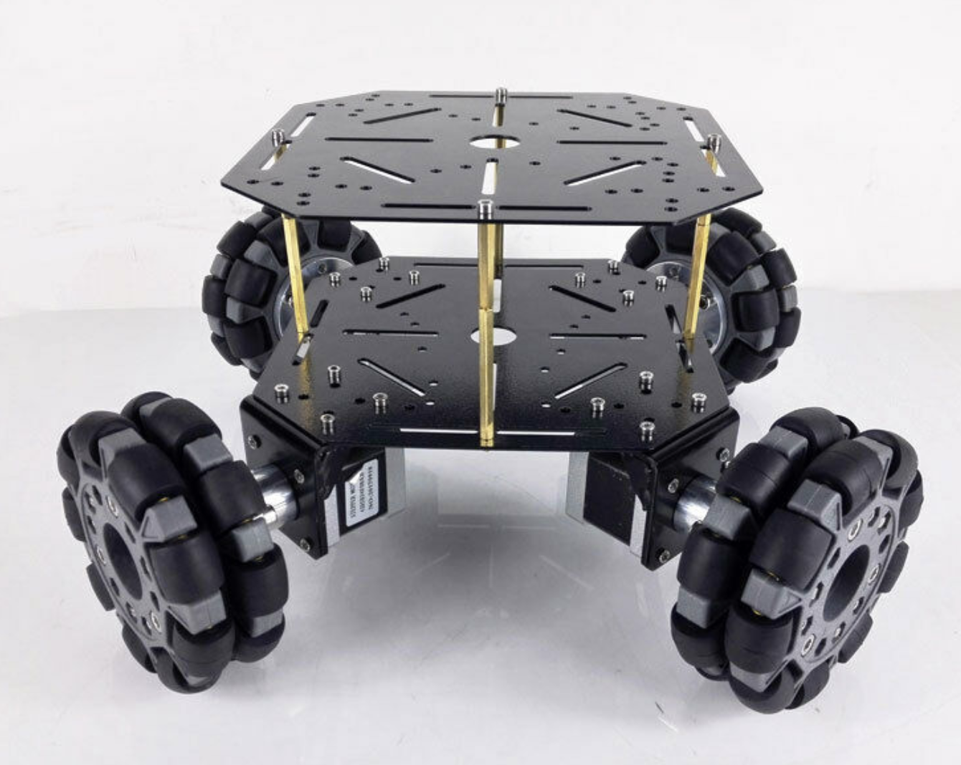
Terminology
Nonholonomic system
A nonholonomic system in physics and mechanics is a system whose state depends on the path taken in order to achieve it.
Nonholonomic constraints are said to be “nonintegrable” -- for example, velocity constraints that cannot be integrated to give a position and orientation.
Some examples to think about:
Cylinder rolling on a plane (about only 1 axis, no slippage)?
Cone rolling on a plane?
Sphere rolling on a plane?
Cart with casters?
Omni Wheels?
Notes:
Talk about ball rolling around
Caster wheels - parallel parking - non-holonomic
Omniwheels - non-holonomic

Slide 12
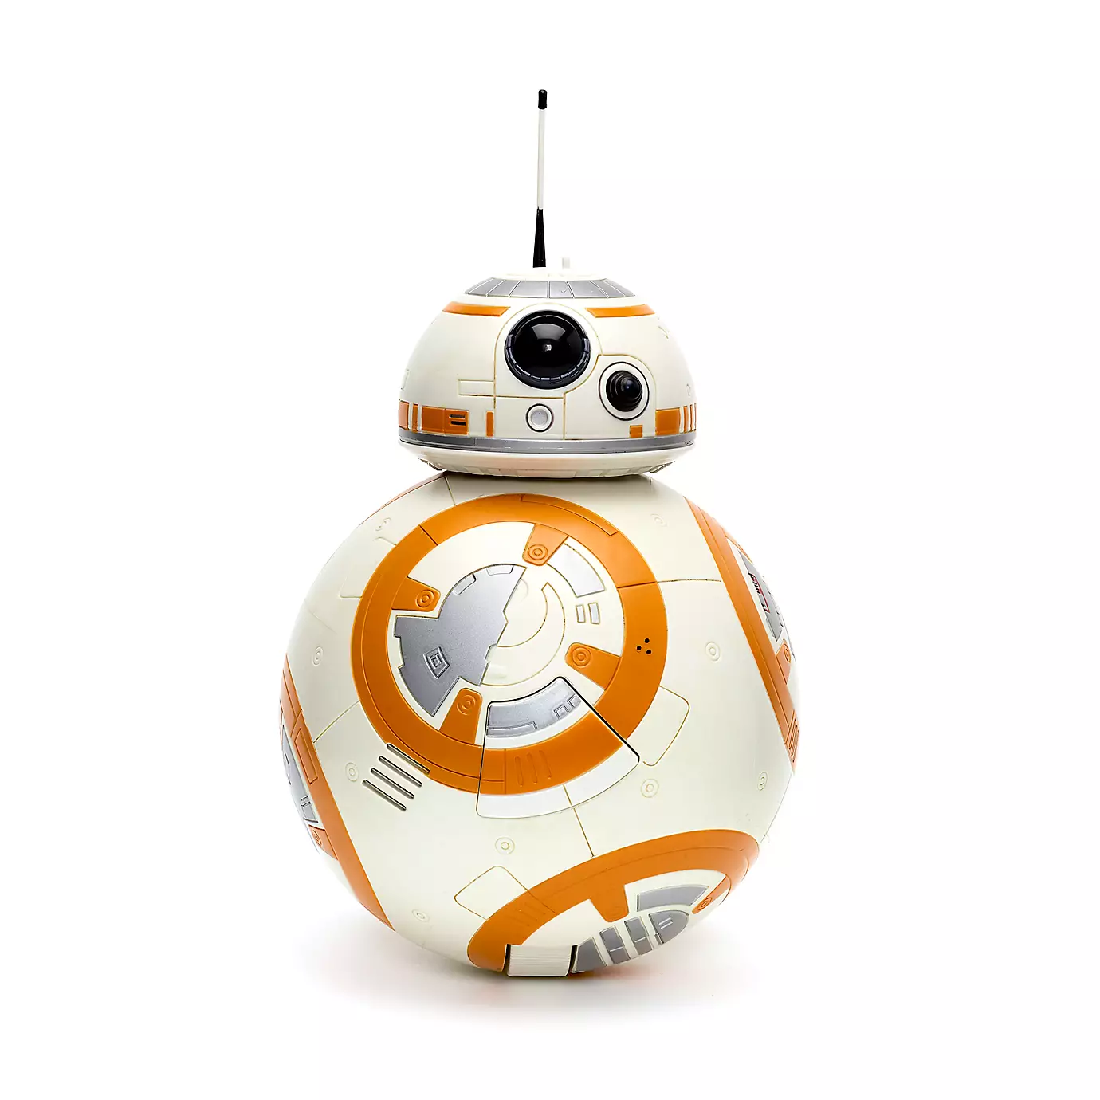
What is any of this good for?
Rolling!
For a given surface, we construct the matrices (K, T, M) that define the manifold.
Having found these matrices, we can relate the velocities of the object (what we know) with the velocity of the contact patch (what we care about)
We need to numerically step through kinematics to determine the final position (because non-holonomic -- no integrable closed-form solution)
Inspired by CMU BallBot: https://youtu.be/O5w_nwIC8_Q

Slide 13
(Muhammad Sunny)

Slide 14
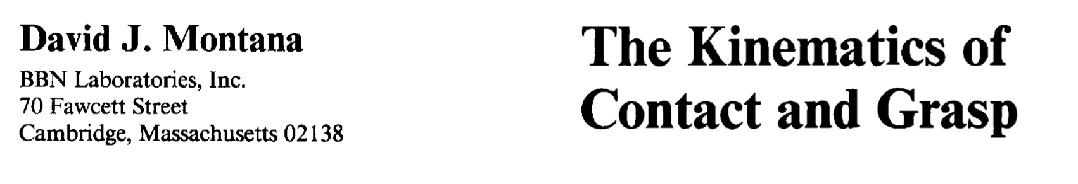
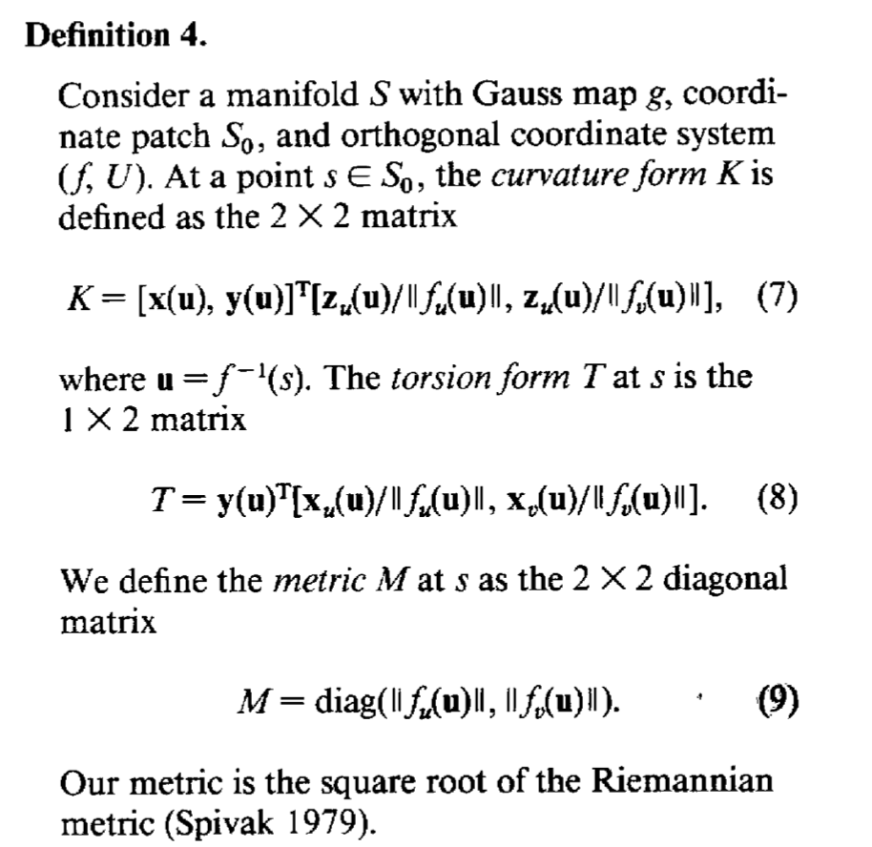
Classic rolling contact paper (cited by anybody who works with rolling in manipulation).
30+ pages and many formal definitions...
Our goal is to make everybody feel like they understand in a basic way how the mathematics work.
We explain the paper and provide an exercise in Sympy, which does the differential geometry algebra. We suggest to go through the script a few lines at a time and check that intermediate results match things in the paper.

Slide 15
Are K, T and M enough to fully describe a surface?
Curvature form: K
What is the curvature here?
K - curvature form ∊ R^{2x2} for a surface
Source: https://en.wikipedia.org/wiki/Metric_(mathematics)
https://www.youtube.com/watch?v=VIqA8U9ozIA
https://www.youtube.com/watch?v=si6ka6HeUdY

Slide 16
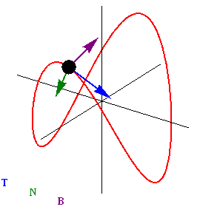
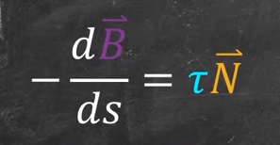
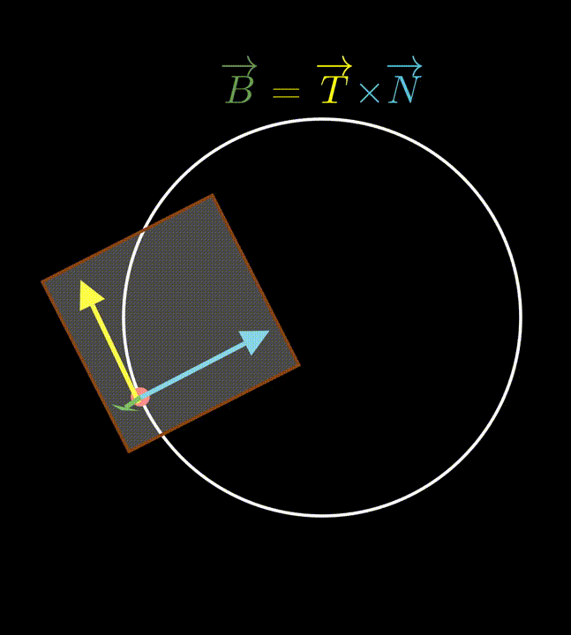
Are K, T and M enough to fully describe a surface?
T - torsion form ∊ R^{1x2} for a surface
M - metric ∊ R^{2x2} for a surface. e.g. Euclidean distance, Riemannian metric
“Determining the distances along the curves through integration is metric tensor.”
How much does the curve twist in space?
Source: https://en.wikipedia.org/wiki/Metric_(mathematics)
https://www.youtube.com/watch?v=VIqA8U9ozIA
https://www.youtube.com/watch?v=si6ka6HeUdY

Slide 17
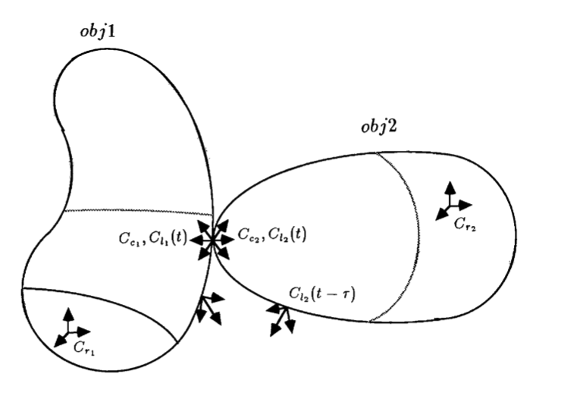
Kinematics of Contact (Contact Equations)
Cr1, Cr2: fixed frames in bodies
Cl1, Cl2: local frames
Cc1, Cc2: (moving) contact frames
Notes:
Cr1 and cr2 are fixed reference frames relative to obj1 and 2 respectively.
We are considering two rigid bodies that are moving relative to each other. We are also aware that rigid bodies make contact at a single point rather than a surface area. Cc1 and Cc2 are those contact points and are mobile. So, at an instantaneous time t, local frames of the objects fixed relative to Cr1 and Cr2 will coincide with the local frames.
Now at that instant t, we can define the parameters that describe the 5 DoF for the motion of this point of contact.

Slide 18
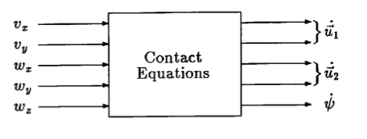
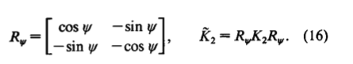
Kinematics of Contact (Contact Equations)
Velocities
of body one
with respect to body two.
Example: 𝝎_{x} is rotation velocity of body one about local x axis.
Velocities of the contact frames themselves -- on the surfaces of the bodies
Compute K1, T1, M1, and K2, T2, M2
Contact Equations: intermediate terms that determine how quantities on the right depend on the quantities on the left (which depends on the shape of the surface)
Notes:
Expressing everything in first object’s frame. R_psi is the orientation of the x- and y-axes of the contact frame 1 relative to x and y-axes of contact frame 2.
Why we need R_psi before and after K2 -- curvature of 2nd object rotated to align with 1st. So, K2 tilda is the curvature of the object 2 at contact point relative to x- and y-axes of the contact frame Cc1.

Slide 19
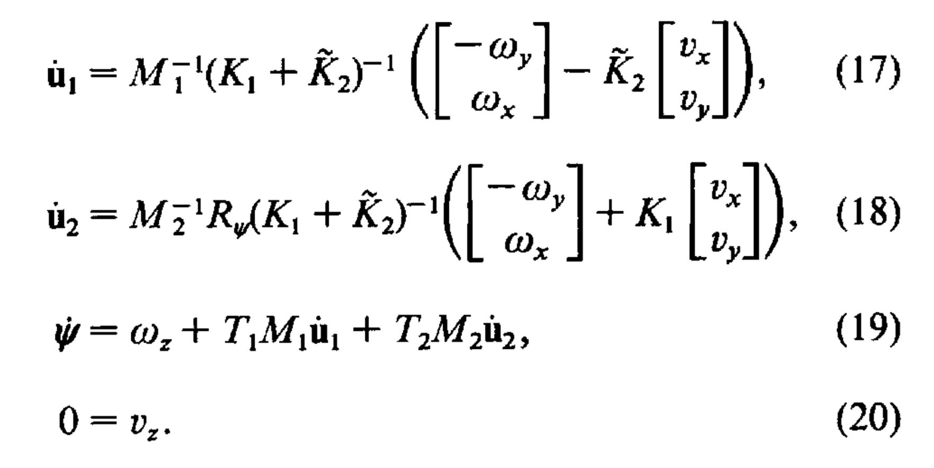
Montana paper
In Sympy...
# Eq 16
Rpsi = Matrix([[cos(psi), -sin(psi)], [-sin(psi), -cos(psi)]])
K2_tilde = Rpsi*Kmat2*Rpsi
# Eq 17
Krel = Kmat1 + K2_tilde
v1gen = Matrix([-omegay, omegax]) - K2_tilde * Matrix([vx, vy])
du1 = Mmat1.inv() * Krel.inv() * v1gen
# Eq 18
v2gen = Matrix([-omegay, omegax]) + Kmat1 * Matrix([vx, vy])
du2 = Mmat2.inv() * Rpsi * Krel.inv() * v2gen
# Eq 19
dpsi = omegaz + (Tmat1 * Mmat1 * du1 + Tmat2 * Mmat2 * du2)[0]
Notes:
In some ways, it is easier to follow the Sympy script, line by line, and inspect the intermediate derived terms to see what they are.

Slide 20
Simplify for no sliding, no spin
du1s = simplify(du1.subs([(vx,0),(vy,0),(vz,0),(omegaz,0)]))
pprint(du1s)
⎡ -R₂⋅omegay ⎤
⎢ ─────────── ⎥
⎢ R₁ + R₂ ⎥
⎢ ⎥
⎢ R₂⋅omegax ⎥
⎢─────────────────⎥
⎣(R₁ + R₂)⋅cos(u₁) ⎦
Speed of the contact patch over the surface have terms proportional to R2/(R1+R2).
(Compare to rolling terms in grasp stiffness exercise, which go just as R*dtheta)
Notes:
Reflect on R1 and R2. Recall why is it different than what we did before -- e.g. for grasp stiffness.
But in that case, the object was flat, so its curvature does not appear.

Slide 21
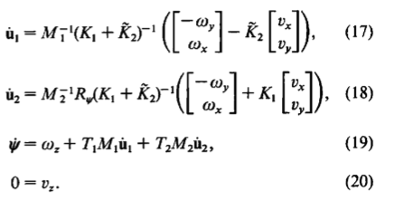
Kinematics of Contact (Contact Equations)
(Symbolic python script steps through this derivation)
Can specialize for different cases (sphere/sphere, sphere/plane, sphere/cylinder). The [K], [M] and [T] matrices will be different in each case.
Update these matrices with each time step and use them in eq. (16-20) to compute velocities and trajectories.
Notes:
Playing with these values (omegax and y, vx and vy) would introduce interesting patterns it can follow

Slide 22
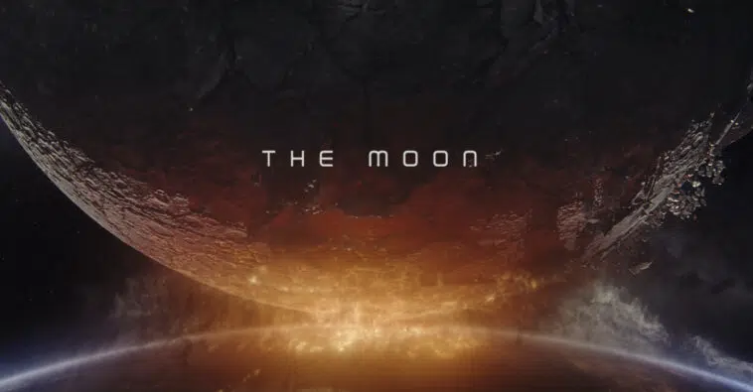
Applications...
MOONFALL (2022) Trailer dell'Epico Sci-Fi Disaster Movie con Halle Berry

Slide 23
(Federico)

Slide 24
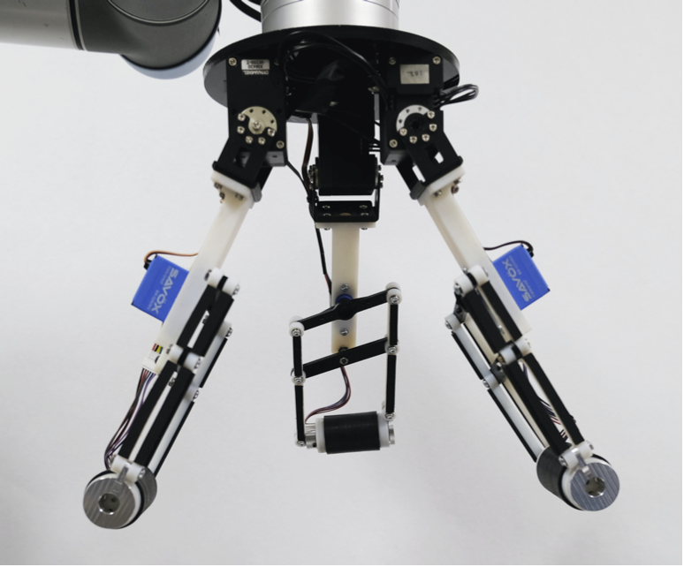
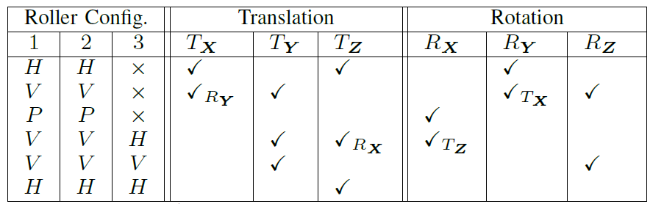
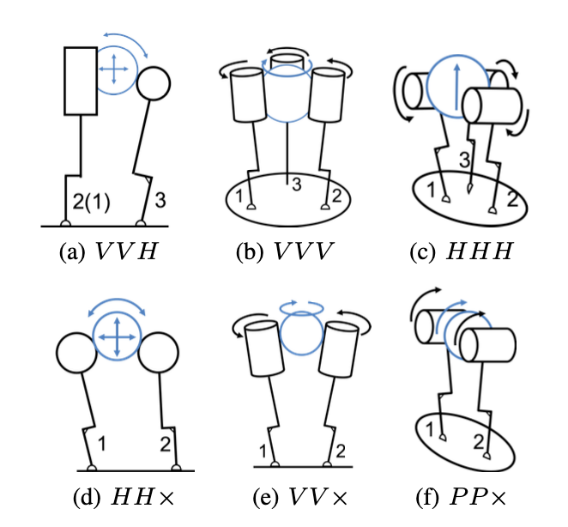
Example #1
Upcoming: Shenli Yuan's Thesis Defense
Time: Dec 7, 2021 08:00 AM Pacific Time (US and Canada)
https://stanford.zoom.us/j/99527994579?pwd=Y2MwS3l1V29HTi9OdWptUTdvWjZiQT09
Password: 041463
Shenli Yuan1, Austin D. Epps, Jerome Nowak, J. Kenneth Salisbury, “Design of a Roller-Based Dexterous Hand for Object Grasping and Within-Hand Manipulation,” IEEE ICRA 2020 - winner of Best Manipulation Paper award

Slide 25

https://drive.google.com/file/d/12gvhEojn2oW1yflHnILCLh7mop1fYHGn/view?usp=sharing

Slide 26
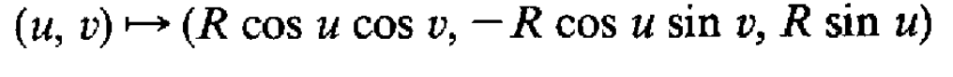
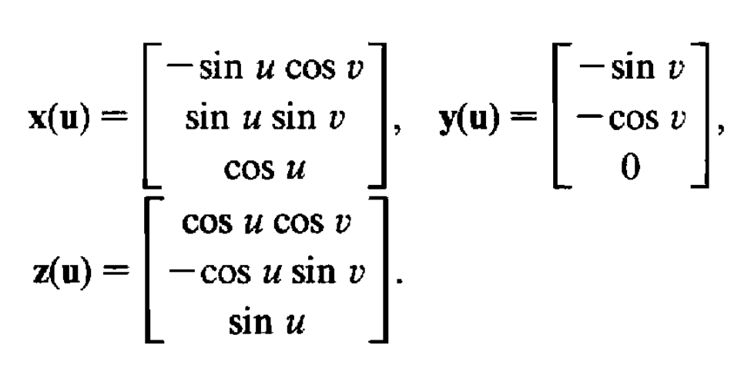
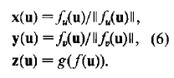
Example #1
Sphere
Cylinder
(u,v) → (Rcosv, -Rsinv, u)
x(u)=[0 0 1]^{T}
z(u)=[cos(v) -sin(v) 0]^{T}
x(u)
x(u)
z(u)
z(u)
u: latitude. v: longitude
u: height. v: angle

Slide 27
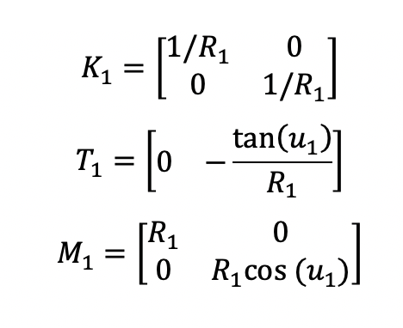
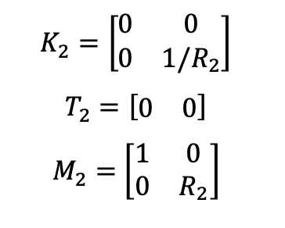
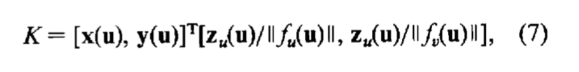
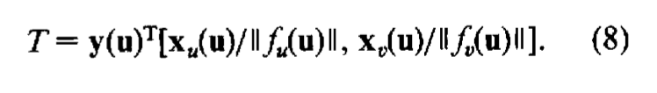
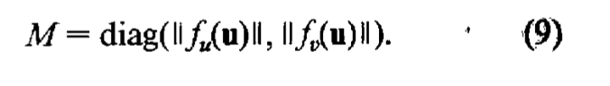
Example #1
Montana, Eq.7-9
Cylinder
Sphere
x
z
x
z

Slide 28
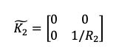
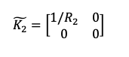
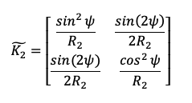
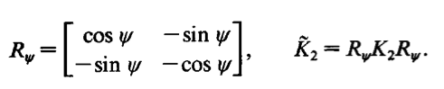
Example #1
Case 1
Case 2
Ѱ=0
x
Ѱ=pi/2
x
z
x
z
z
z
y

Slide 29
Example #1
Case 1
Case 2
Initial Orientation:
Ѱ=pi/2
Conditions:
No slip:
v_{x}=0
v_{y}=0
In contact:
v_{z}=0
Custom defined:
⍵_{x}=π (rad/s)
⍵_{y}=0
⍵_{z}=0
Known initial Locations:
u1, v1, u2, v2 = 0
Known initial Orientation:
Ѱ=0
x
x
z
x
z
z
z
y

Slide 30
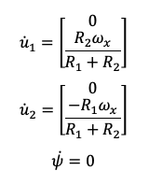
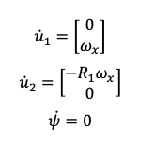
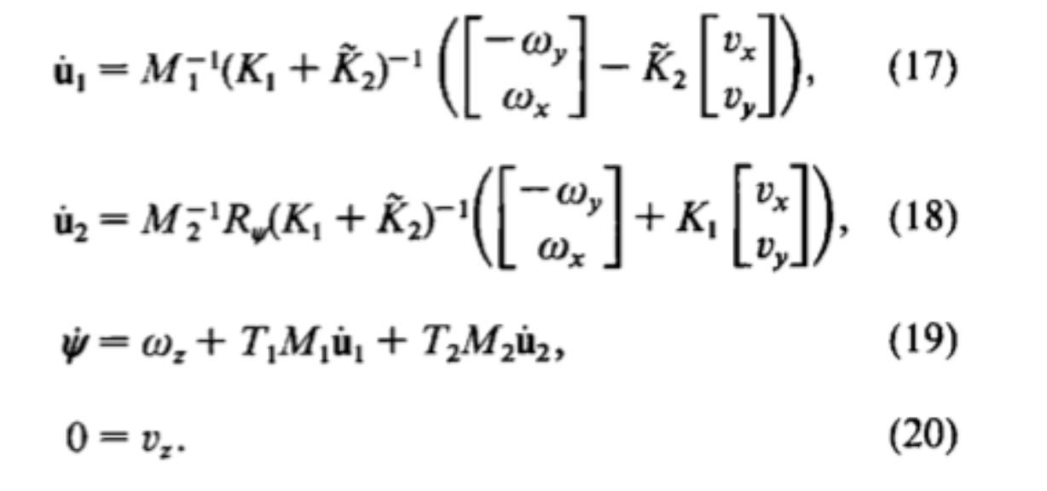
Example #1
Case 1
Case 2
x
x
z
x
z
z
z
y
Notes:
Case 1: same as moon-earth example (gear ratio)
Case 2: same as sphere rolling on a flat plate

Slide 31

Example #1
Shenli Yuan1, Austin D. Epps, Jerome Nowak, J. Kenneth Salisbury, “Design of a Roller-Based Dexterous Hand for Object Grasping and Within-Hand Manipulation,” IEEE ICRA 2020 - winner of Best Manipulation Paper award
Notes:
Case 1: same as moon-earth example (gear ratio)
Case 2: same as sphere rolling on a flat plate

Slide 32
(Ebrahim ⇒ Mark)

Slide 33


Example #2 Velvet Fingers @UniPi Centro Piaggio
Velvet fingers: A dexterous gripper with active surfaces. https://drive.google.com/drive/folders/1I1pYoH2tEftNzy6uw15T6PJBrbSrV_9J?usp=sharing, V., Catalano, M. G., Farnioli, E., Garabini, M., Grioli, G., Fantoni, G., & Bicchi, A. (2012, October). 2012 IEEE/RSJ (IROS) Velvet Fingers: Grasp Planning and Execution for an Underactuated Gripper with Active Surfaces, Robert Krug, Todor Stoyanov, Manuel Bonilla, Vinicio Tincani, Narunas Vaskevicius, Gualtiero Fantoni, Andreas Birk, Achim Lilienthal and Antonio Bicchi. (2014) IEEE ICRA
https://youtu.be/eIvsmWGa4FQ

Slide 34


Example #2 Velvet Fingers @UniPi Centro Piaggio
“...we address the grasp planning problem by adapting the well known optimization based planning scheme introduced by Ciocarlie and Allen [8] to the specifics of underactuated gripper designs.” (GraspIt!) “… A wrench-based geometric quality criterion, such as the one introduced by Ferrari and Canny [19], is usually used to rank the grasps.” (Week4)

Slide 35



Example #2 Velvet Fingers @UniPi Centro Piaggio
“It is possible to demonstrate that a minimum set of equations describing the displacement of the system around an equilibrium configuration can be written in the form Aδy = 0, thus as a linear and homogeneous set of equations. The coefficient matrix A ∈ Rra×ca depends on the Jacobian matrix, the Grasp matrix, …”
What kinds of terms do the 𝚪 represent?

Slide 36

The Assignment for Week 5
Q1: Derive [K], [M] and [T] matrices per Montana. We provide the [K] derivation in Sympy, you add some lines to get [M] and [T] and verify that intermediate derived quantities make sense in terms of the paper.
Q2: We provide a script for a sphere rolling on a plane. Can you adjust the angular velocities of the sphere to get contact coordinates that trace a circle on the plane?
From: Nakashima, Akira. "Control for Robot Fingers with Nonholonomic Constraints." D. Engr. thesis, Nagoya University (2005).

